Slide 1
INFO 341 All Things Wireless Overview
By
Bob Larson

Slide 2
Technologies We Will Introduce
WiFi technologies and networks
What is LiFi?
What is Zigbee?
Bluetooth networks & Bluetooth Smart
Cellular technologies and networks
Sat Nav (GPS) networks and uses*
RFID Technology and uses*
The Internet of Things (IoT)
* Why? Not data networks

Slide 3
Wireless Everywhere
Connecting without wires or fibers (glass)
Increasing mobility
Easy to install and setup – often little or nothing
Initially included many security vulnerabilities
Getting better
At the heart of the Internet of Things (IoT)
Wave technologies that allow us to piggyback data
If not the future, a huge part of it

Slide 4
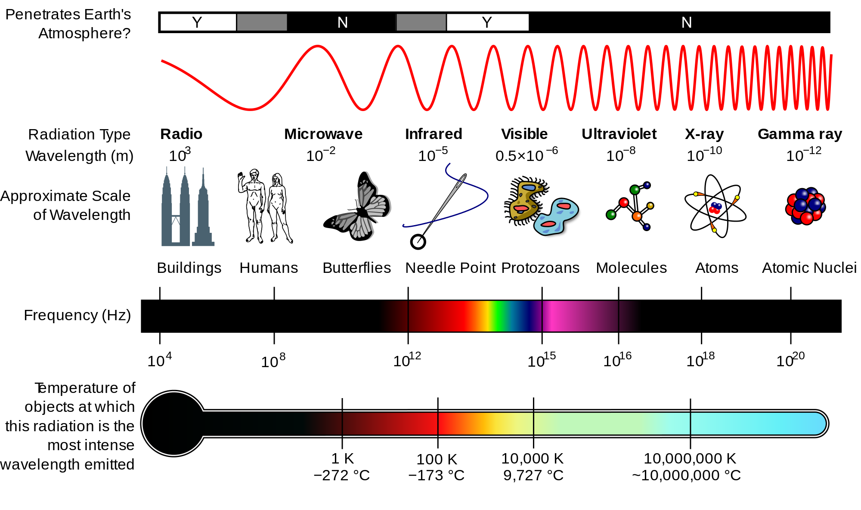
Electromagnetic Spectrum - Wikipedia

Slide 5
Types of Wireless Networks
Wireless Personal Area Networks (WPANs)
Wireless LAN (WLAN)
Wireless Mesh or ad hoc Network
Wireless Metropolitan Area Network (MAN)
Wireless Wide Area Network (WWAN)
Global Area Network and Space Network
Cellular Network

Slide 6

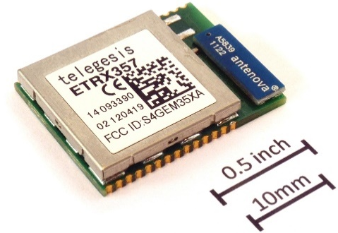
Wireless Personal Area Networks (WPANs)
Connect devices within a relatively small area
Bluetooth radio – connect accessories to PCs, tablets, etc.
Mouse, speakers, headsets, media players, gaming equipment
Short-wavelength UHF radio waves – ISM band 2.4 to 2.485 GH
Max distance 30 feet – master/slave architecture (1 / up to 7 slaves)
Developed by Ericsson Mobile in Lund, Sweden
Name for King Harald Bluetooth who united Danish tribes (10th century)
Infrared light – remote controls using narrow focus LED
ZigBee – (IEEE 802.15.4) designed for small scale embedded projects
Uses small, low-power digital radios, low-bandwidth, and low data rates
Home/building automation, medical device data collection, smoke and intruder warning, industrial controls, and other data collection

Slide 7

Wireless LAN (WLAN) – Wi-Fi brand name
IEEE 802.11 (a/b/g/n/ac) Standards
Each standard is revoked as upgraded – industry still uses designation
First wireless network: 1971 University of Hawaii, ALOHAnet
Connected seven computers on four islands to Oahu computer
Connections are stations (STA): Access Point (A/P) and clients
Two basic modes of operation:
Infrastructure – clients connect to A/P to bridge to other networks
LAN or Internet
ad hoc – mobile units transmit directly to each other (peer-to-peer)
Operates in both the 2.4 GHz and 5 GHz bands

Slide 8
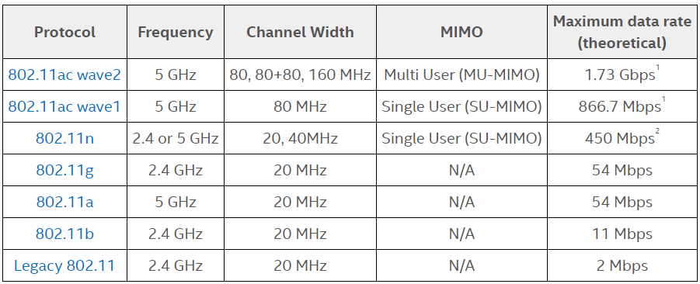
IEEE 802.11 Wi-Fi Protocol Summary
*
* Multiple-Input and Multiple-Output (MIMO)

Slide 9
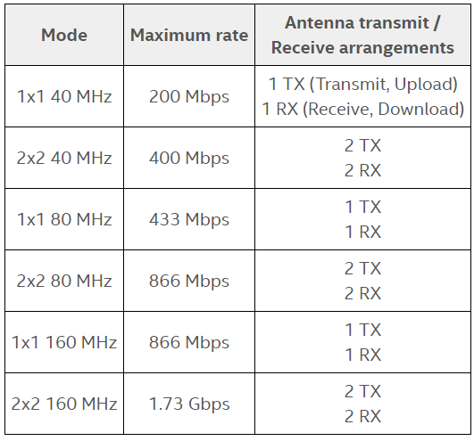
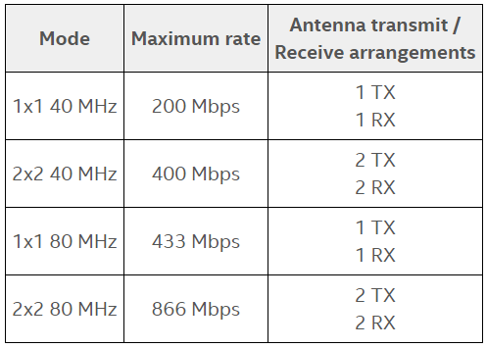
802.11ac wave2 vs wave1
802.11ac wave2 (June 2016)
802.11ac wave1 (January 2014)

Slide 10
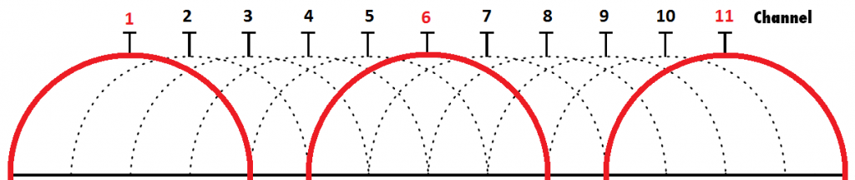
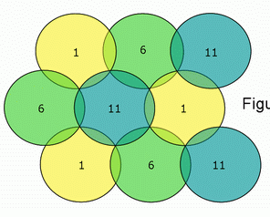
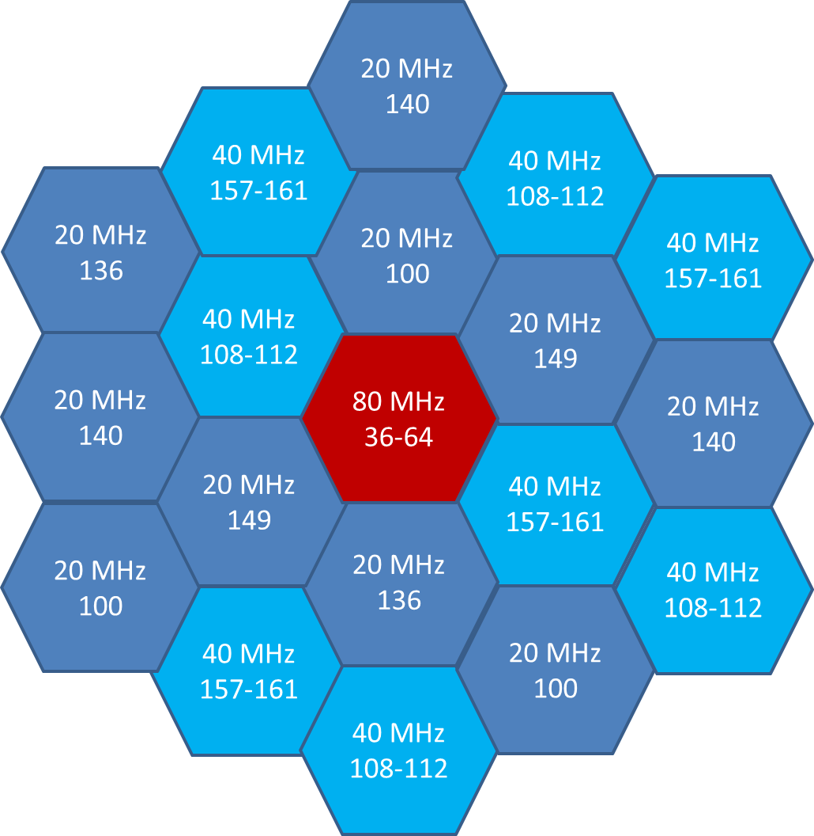
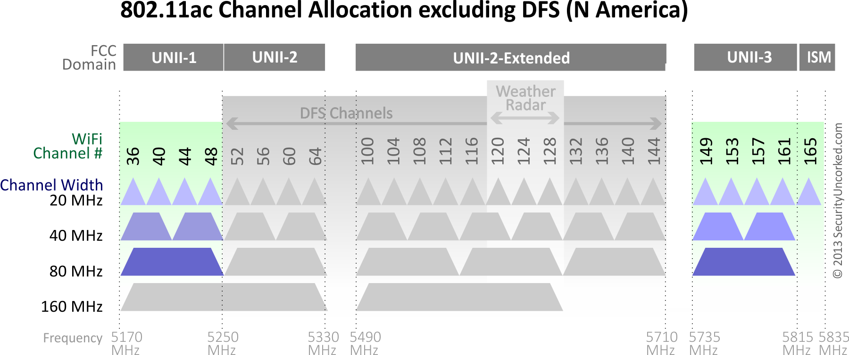
Channels and Multi-A/P Installation
2.4 GHz
5 GHz

Slide 11
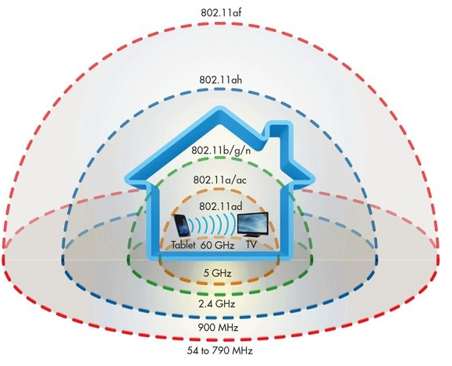
Distance Comparison & the Future
What about the future?
802.11ad
Very high 60 GHz frequency
Data speeds to reach around 7 Gbit/s
Trade-off is range and walls
Requires direct line of sight to router
802.11ah standard, (WiFi HaLow)
1 kilometer (3,300 ft)
Use 900 MHz – much lower frequency
Speeds 150 Kbit/s to 18 Mbit/s (slow)
802.11af, (White-Fi or Super WiFi)
Uses TV spectrum 54 MHz to 790 MHz
Potentially with miles of coverage
Possible IoT uses

Slide 12
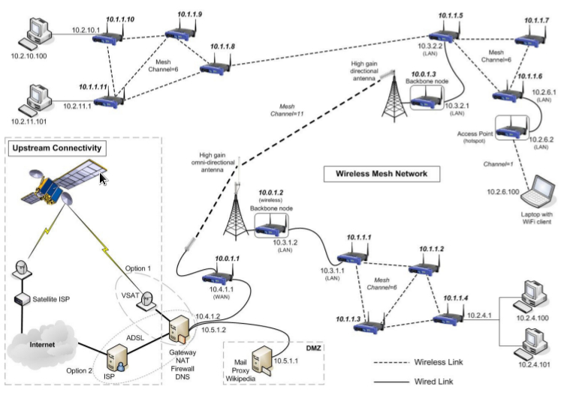
Wireless Mesh or ad hoc Network
Sometimes called a mesh cloud
Mesh clients, routers and gateways
Reliable and offers redundancy
Routers forward to/from gateways
May connect to the Internet
Clients: any wireless devices
Node Mobility is less frequent
Updating routes vs. delivering data
Military use in field operations
Electric smart meters
Transfer readings one to another
Eventually to the central office
Google Home, Google Wi-Fi, and Google OnHub
Iridium satellite constellation
Satellite Phones
https://commons.wikimedia.org/w/index.php?curid=30799980

Slide 13
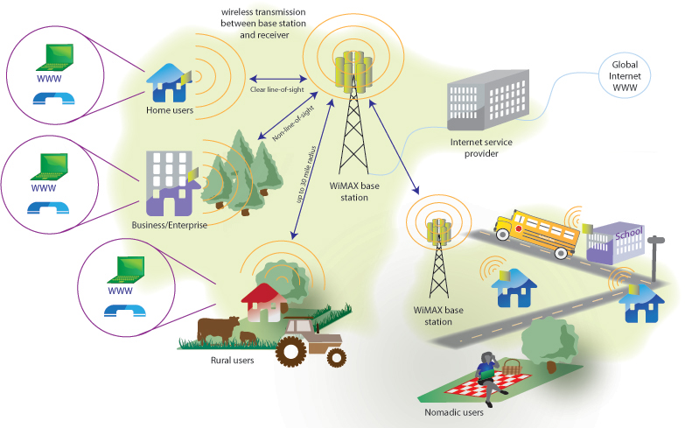
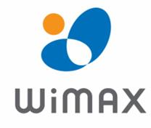
Wireless Metropolitan Area Network (MAN)
IEEE 802.16 standard (WiMAX was example)
Connects several wireless LANs
Originally 30 to 40 Mbps (2011 update to 1 Gbit/s)
Connectivity across cities and countries
Wireless alternative to cable and DSL for "last mile" broadband access
Providing data, telecommunications (VoIP) and IPTV (triple play)
Smart grids and metering
Mobile WiMax was considered
A replacement candidate for cellular technologies (GSM and CDMA)
As an overlay to increase capacity
Fixed WiMAX was also considered
A wireless backhaul technology for 2G, 3G, and 4G networks

Slide 14
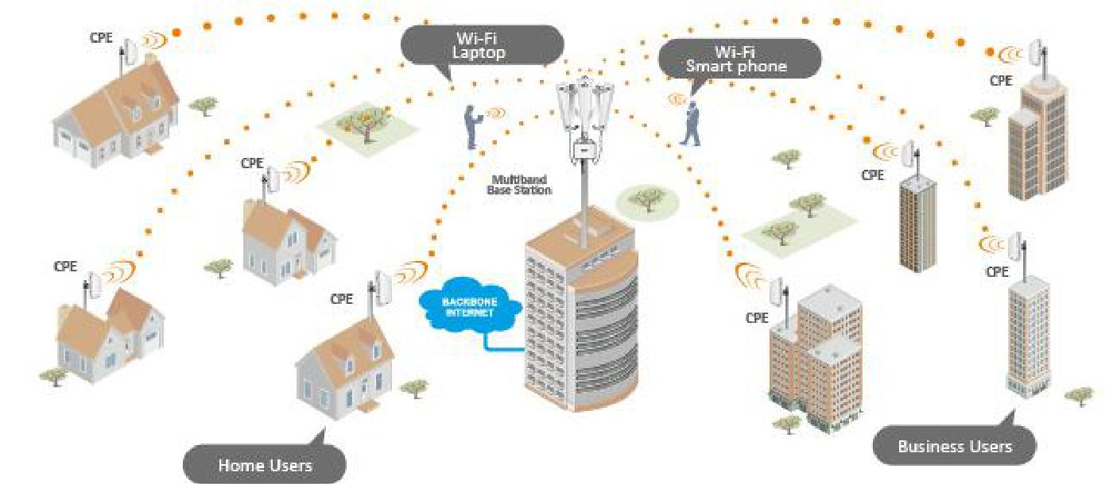
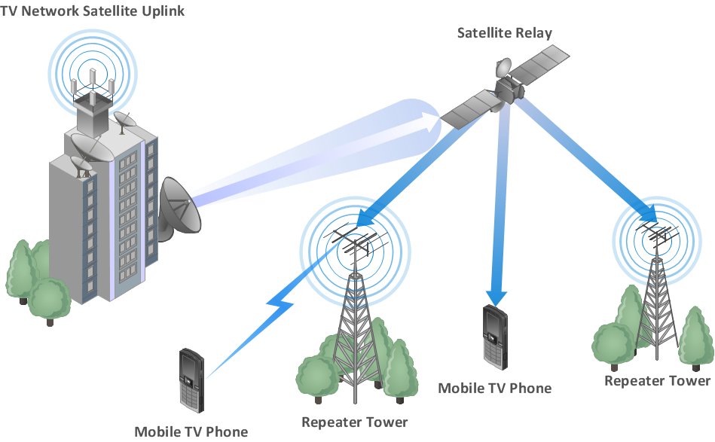
Wireless Wide Area Network (WWAN)
Larger geographical area than Wireless MAN
Typically uses cellular network technology such as LTE
Laptop/tablet with a WWAN (cellular) card can – same as Smartphone Internet
Surf the web, check email, or connect to a VPN
Can be a closed network like a mesh network (MANET)
With nodes on building, tower, trucks, and planes
Since radio communications systems are not physically secure
Typically incorporate encryption and authentication methods

Slide 15
Global Area Network and Space Network
Global Area Network
IEEE 802.20 or Mobile Broadband Wireless Access (MBWA)
No longer being actively developed (still some iBurst in ZA)
Support mobile across a wireless LANs, satellite coverage areas, etc.
Challenge is handing off user from one local area to the next
Space Network
Communication between spacecraft and ground elements
Example: NASA's Space Network at Goddard Space Flight Center (GSFC)
The geosynchronous Tracking and Data Relay Satellites (TDRS),
Supporting ground terminal systems,
The Bilateration Ranging and Transponder System (BRTS),
Merritt Island Launch Annex (MILA) relay,
Network Control Center Data System (NCCDS).

Slide 16
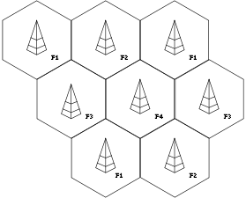
Cellular Network
Mobile radio network
Distributed over land areas called cells
Each served by at least one fixed-location transceiver
Known as a cell site or base station (tower)
Each uses a different set of radio frequencies (channel) than adjacent cells
Channel Reuse – Like Wi-Fi to use limited number of channels
Covers a wide geographic area with many users
Fixed transceivers and mobile telephones
Supports transceivers moving from cell to cell during transmission
Originally designed for cell phone communications
With the development of smartphones, routinely carry data

Slide 17

Cellular Network Systems
Global System for Mobile Communications (GSM)
Originally Groupe Spécial Mobile (Finland 1991)
Global standard in 2014 – used by most cell phones
Divided into three major systems:
Switching system
Base transceiver system (BTS)
Operation and support system
Cell phone connects to the base transceiver system (BTS) – base station (old term)
Which connects to the operation and support station
Which connects to the switching station to transfer call to where it needs to go
Personal Communications Service (PCS)
Radio band available in North America and South Asia
Sprint was the first service to set up a PCS
Digital Advanced Mobile Phone Service (D-AMPS) - being phased out

Slide 18
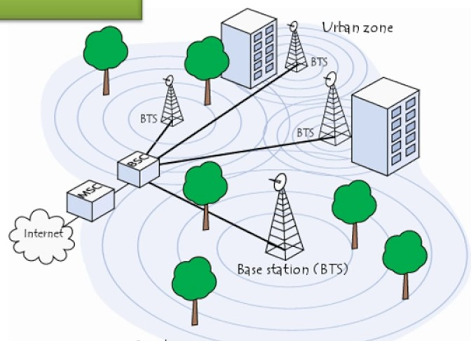
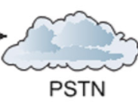

Cellular Networks
Account Data

Slide 19
1G, 2G, 3G, 4G & 5G Wireless
1G: Voice Only (in the 1980s)
Analog technology, poor battery life and voice quality, sometimes dropped calls
Max speed of 1G is 2.4 Kbps
2G: Short Message Service (SMS), Multimedia Messaging Service (MMS) and data
1991 with GSM networks (Finland) took cell phones digital
Introduced call and text encryption, plus data services like SMS, picture messages, and MMS
Max speed 50 Kbps or 1 Mbps
3G: More Data! Video Calling & Mobile Internet (1998)
Max speed 2 Mbps for non-moving devices and 384 Kbps in moving vehicles
4G: The Current Standard (2008)
Added gaming services, HD mobile TV, video conferencing, 3D TV and higher speeds
Max speed moving is 100 Mbps or 1 Gbps when stationary or walking
5G: Coming Soon (2018 or later) – three flavors being tested
Millimeter wave 5G offers higher capacity than 4G and lower latency
Speeds 490 megabits to 1.4 gigabits

Slide 20
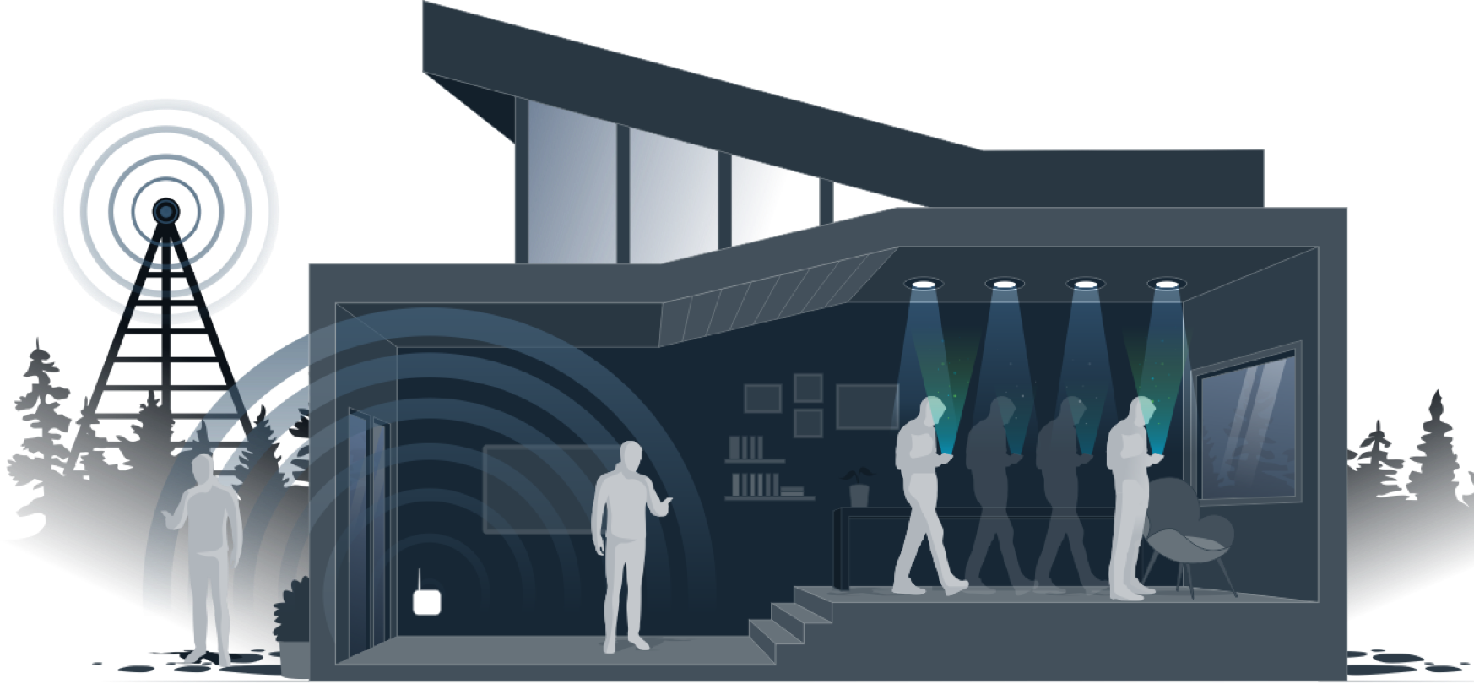
Light Fidelity (Li-Fi)

Slide 21
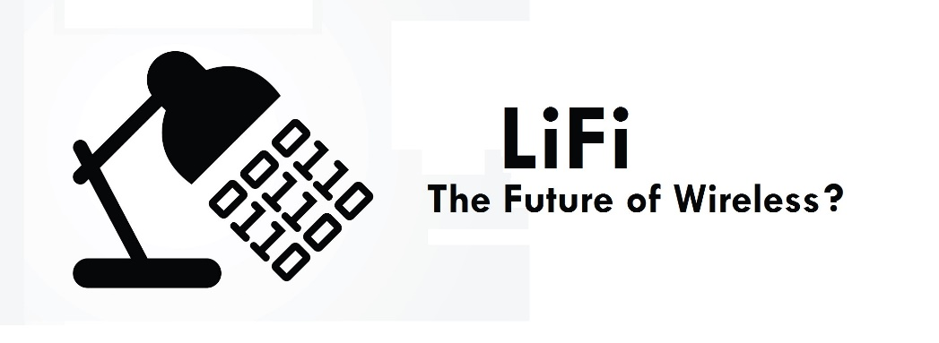
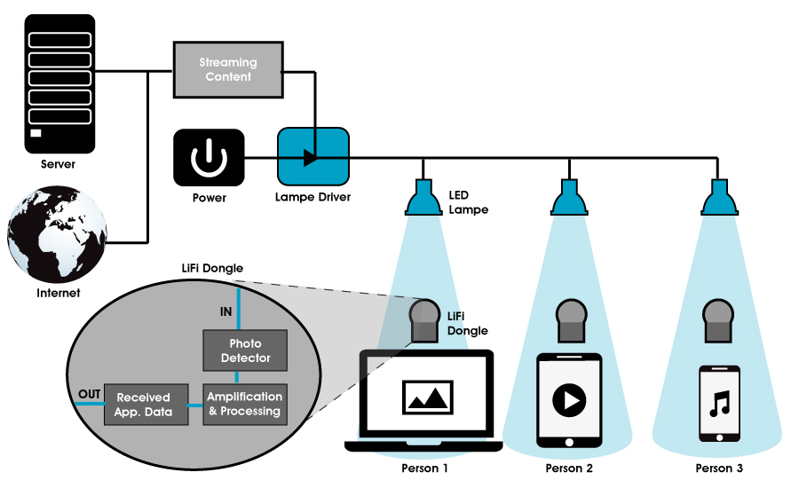
Li-Fi Components

Slide 22
Global Positioning System (GPS)
Originally Navstar GPS owned by the US government (Launched 1973)
Operated by the United States Air Force
Operates independently of any telephonic or internet reception
These technologies can enhance the usefulness of positioning information
During the 1990s, GPS quality was degraded by the US government
Program called "Selective Availability“ for civilian and non-military use
Discontinued in May 2000 by law signed by former President Bill Clinton
New GPS receiver devices using the L5 frequency (Beginning in 2018)
Expected to pinpoint a device to within 30 centimeters (just under one foot)
Other systems under development
European Union Galileo positioning system, China's BeiDou Navigation Satellite System, India's NAVIC and Japan's Quasi-Zenith Satellite System
US can selectively deny access – Indian military in 1999 during the Kargil War

Slide 23
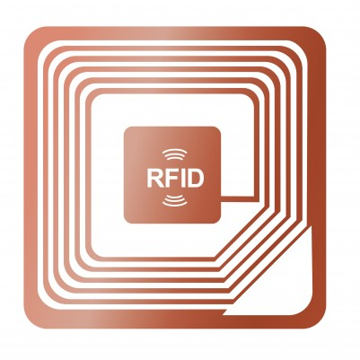
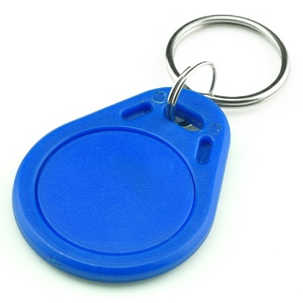
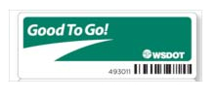
Radio-Frequency Identification (RFID)
Uses electromagnetic fields to identify and track tags attached to objects
Tags contain electronically stored information
Passive tags collect energy from a nearby RFID reader's interrogating radio waves
Active tags have a local power source (such as a battery)
Can operate hundreds of meters from the RFID reader
Unlike a barcode, the tag needn’t be within the line of sight of the reader
It can be embedded in the tracked object including animals and people
Reading personal info without consent raises serious privacy concerns
Various ISO/IEC standard specifications addressing privacy and security issues
Tags can be used in shops to
Expedite checkout
Prevent theft by customers and employees

Slide 24
Internet of Things
Items growing everyday
All aspects of our lives – personal and work
No part of our lives will go untouched
Increases the threats to our networks
Data networks
The Internet
Will get better over time
Too often the initial race to market ignores security
Market driven before standards (and horror stories) evolve
Look at Top 5 Internet of Things (IoT) Infographics

Slide 25
Fin…

